Slide 1
RSA Accumulators, Consensus and Aggregate Signatures
CSCI-GA 3033-107
https://brightspace.nyu.edu/d2l/home/353819
Benedikt Bünz
New York University
[discussion on brightspace]
[first homework – online due 9/2/24]

Slide 2
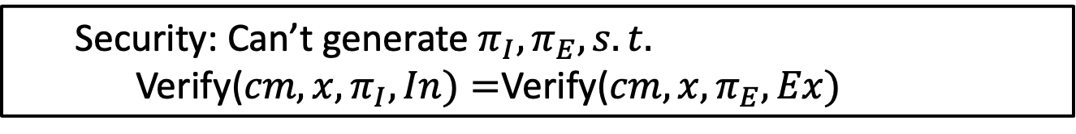
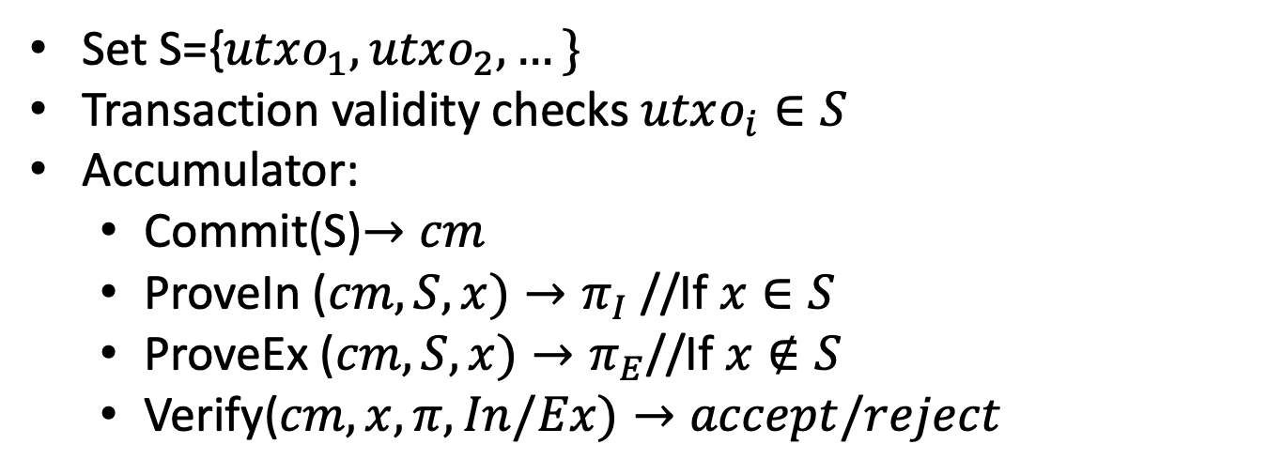
Recap: UTXO Set Accumulators
Set S={$utxo_{1},utxo_{2},…\}$
Transaction validity checks $utxo_{i}∈S$
Accumulator:
Commit(S)$→cm$
ProveIn ($cm,S,x)→π_{I}$ //If $x∈S$
ProveEx ($cm,S,x)→π_{E}$//If $x∉S$
Verify($cm,x,π,In/Ex)→accept/reject$
Security: Can’t generate $π_{I},π_{E}, s.t.$
Verify($cm,x,π_{I},In)=$Verify($cm,x,π_{E},Ex)$

Slide 3
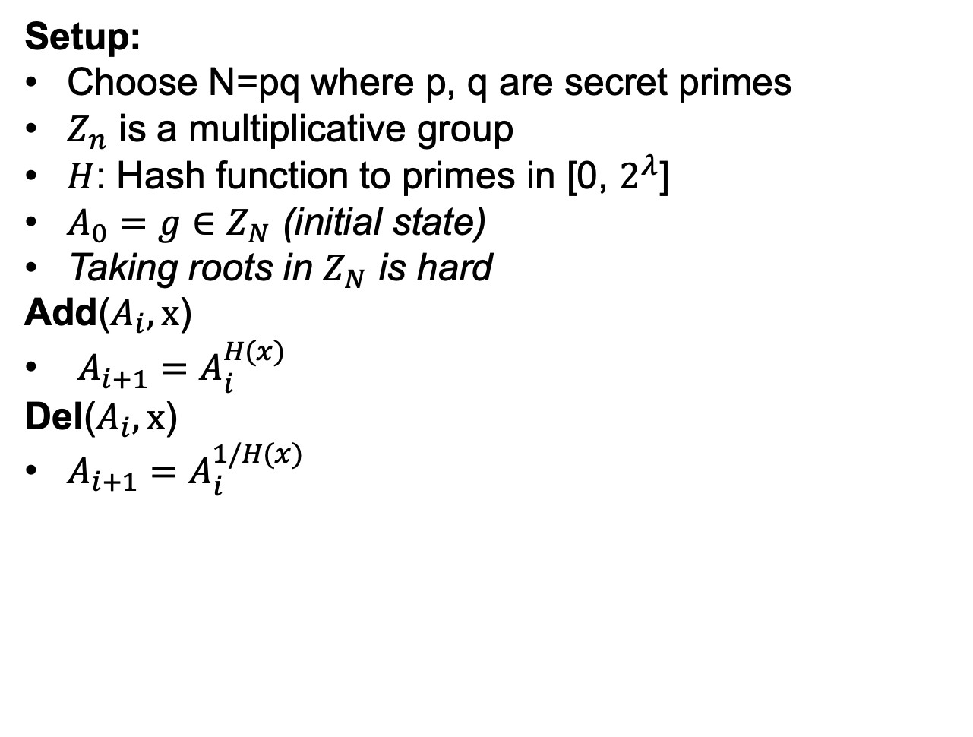
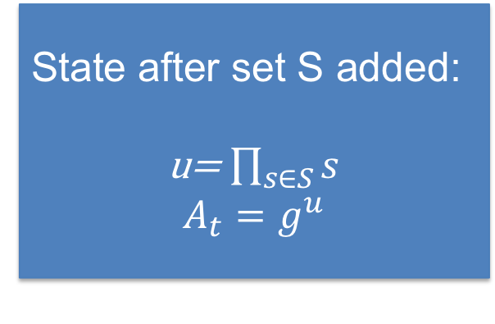
RSA Accumulators [CL02, LiLiXue07,BBF19]
Setup:
Choose N=pq where p, q are secret primes
$Z_{n}$ is a multiplicative group
$H$: Hash function to primes in [0, $2^{λ}$]
$A_{0}=g∈Z_{N}$ (initial state)
Taking roots in $Z_{N}$ is hard
Add($A_{i},x$)
$A_{i+1}=A_{i}^{H(x)}$
Del($A_{i},x$)
$A_{i+1}=A_{i}^{1/H(x)}$
State after set S added:
u= $\prod_{s∈S}{s}$
$$A_{t}=g^{u}$$
Notes:
We’ll omit H

Slide 4
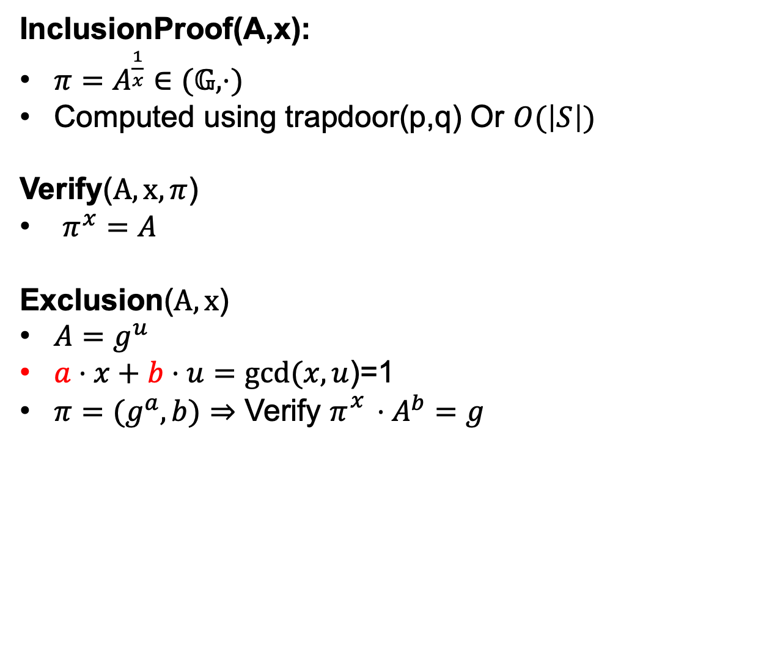
Accumulator Proofs
InclusionProof(A,x):
$π=A^{\frac{1}{x}}∈(𝔾,⋅)$
Computed using trapdoor(p,q) Or $O(\left|S\right|)$
Verify($A,x,π$)
$π^{x}=A$
Exclusion($A,x$)
$A=g^{u}$
$a⋅x+b⋅u=gcd⁡(x,u$)=1
$π={(g}^{a}, b)⇒$ Verify $π_{}^{x}⋅A^{b}=g$
Efficient stateless updates to (non)-membership witnesses:
[LiLiXue07]

Slide 5
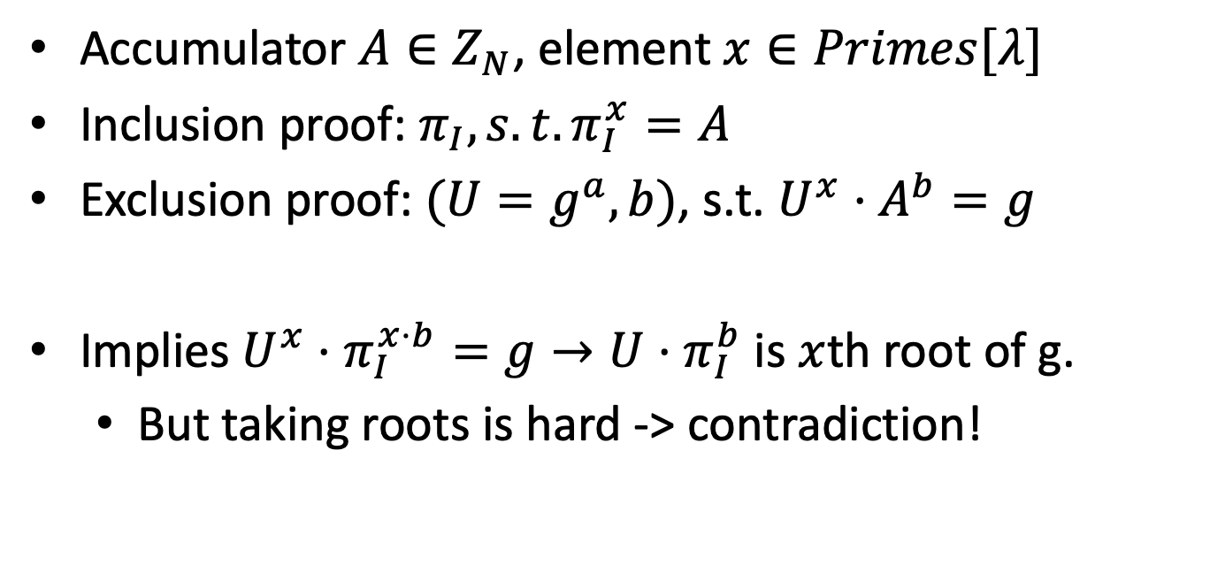
RSA Acc Security
Accumulator $A∈Z_{N}$, element $x∈Primes[λ]$
Inclusion proof: $π_{I},s.t. π_{I}^{x}=A$
Exclusion proof: $(U=g^{a},b)$, s.t. $U^{x}⋅A^{b}=g$
Implies $U^{x}⋅π_{I}^{x⋅b}=g→U⋅π_{I}^{b}$ is $x$th root of g.
But taking roots is hard -> contradiction!

Slide 6
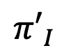
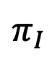

Aggregating membership witnesses
$$π_{I}$$
$${π′}_{I}$$
$${π′′}_{I}$$
UTXO accumulator
Normally: k transactions k proofs

Slide 7

Aggregating membership witnesses
$$π_{I}$$
$$π_{I}^{A}$$
$${π′}_{I}$$
$${π′′}_{I}$$
UTXO accumulator
Aggregate proofs into one: Saves space

Slide 8
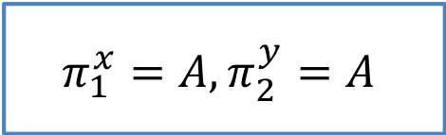
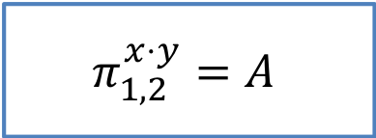
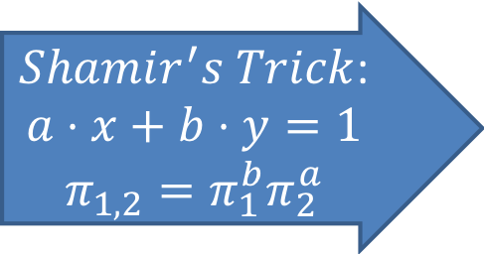
Aggregate Membership Witnesses
$Shamir^{′}s Trick$:
$$a⋅x+b⋅y=1$$
$$π_{1,2}=π_{1}^{b}π_{2}^{a}$$
$$π_{1}^{x}=A,π_{2}^{y}=A$$
$$π_{1,2}^{x⋅y}=A$$
All membership witnesses per transaction block: ~3000 bits
Notes:
Remember if merkle trees than 160gb

Slide 9
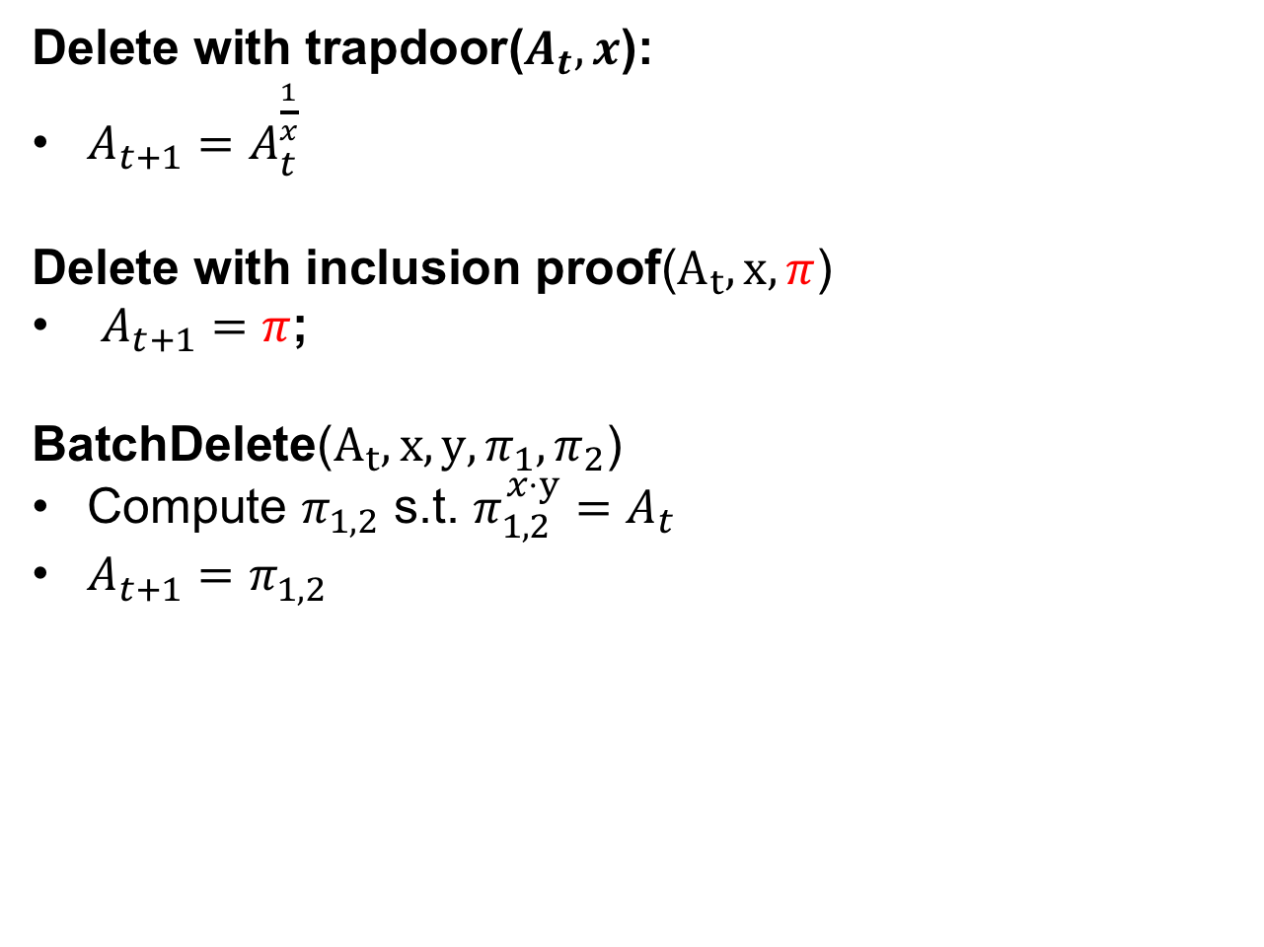

Stateless Deletion
Delete with trapdoor($A_{t},x$):
$A_{t+1}=A_{t}^{\frac{1}{x}}$
Delete with inclusion proof($A_{t},x,π$)
$A_{t+1}=π$;
BatchDelete($A_{t},x,y,π_{1},π_{2}$)
Compute $π_{1,2}$ s.t. $π_{1,2}^{x⋅y}=A_{t}$
$A_{t+1}=π_{1,2}$
Using knowledge of p, q
$$π=g^{\frac{u}{x}}$$
No State,
no Trapdoor,
asynchronous
Notes:
Unclear

Slide 10
Much more accumulators
Many more accumulator and list commitment constructions
E.g. from polynomial commitments (later lectures)
Active research area

Slide 11
Consensus

Slide 12
Blockchain Layers
Layer 3:
user facing tools (cloud servers)
Layer 2:
applications (DAPPs, smart contracts)
Layer 1.5:
compute layer (blockchain computer)
Layer 1:
consensus layer

Slide 13


Blockchain Forks
TX_{A}: Send 3 BTC to Bob
TX_{A}
…
TX_{A}: Send 3 BTC to herself
TX_{A}

Slide 14
Double Spending
Alice can create two transactions spending the same UTXO!
One sends money to Bob, the other sends the UTXO to herself.
Only the ‘first’ transaction should go through
-> There needs to be a global consensus on the ordering of transactions.
Concretely, there needs to be an agreement which block extends the blockchain (Fork Choice Problem)

Slide 15

Block choice
New Block
Reject?
Accept
Block A
Reject
404

Slide 16
Consensus
Accepts/Rejects TXs
Leader
Committee

Slide 17
Consensus
Security Properties:
Consistency: Honest nodes do not contradict
Liveness: Progress is made
Network Models
Synchronous: Messages get delivered immediately
Partially Synchronous: Messages are out of order

Slide 18
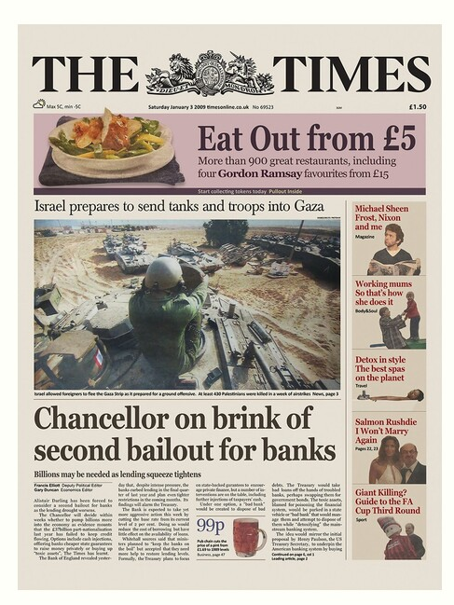
Recap
genesis block
BH₃
BH₁
BH₂
version (4 bytes)
prev (32 bytes)
time (4 bytes)
bits (4 bytes)
nonce (4 bytes)
Tx root (32 bytes)
prev
Tx root
prev
Tx root
H
H
H
…
80 bytes
coinbase Tx
coinbase Tx

Slide 19
Nakamoto Consensus
BH₁
BH₂
PoW:
Find nonce s.t.
H(Block)<Target
Target s.t. blocks found every 10 min
Genesis
H(Gen)
Time
Nonce
Root
H(BH₁)
Time
Nonce
Root
H
H
H
H(BH₂)
Time
Root
H(BH₂)
Time
Root
coinbase Tx
Notes:
4 bytes

Slide 20
Nakamoto Consensus
BH₁
BH₂
BH₃
Genesis
Prev
Time
Nonce
Root
Prev
Time
Nonce
Root
H
H
H
H
H(BH₂)
Time
Root
H(BH₂)
Time
83512
Root
coinbase Tx
Notes:
4 bytes

Slide 21
Nakamoto Consensus
BH₁
BH₂
BH₃
Genesis
Prev
Time
Nonce
Root
Prev
Time
Nonce
Root
H(BH₂)
Time
83512
Root
H
H
H
H
H(BH₂₃)
Time
Root
H(BH₃)
Time
Root
coinbase Tx
Notes:
4 bytes

Slide 22
Nakamoto Consensus
PoW:
Find nonce s.t.
H(Block)<Target
Miners “race” to add blocks
Prepare Block Template
Find nonce (PoW solution)
One winner every ~10 min
Target adjusted every 2 weeks
Probability winning ~ Computation power
PoW secure
Prev
Time
Root
Prev
Time
Root
Notes:
4 bytes

Slide 23
Nakamoto Consensus
Miners “race” to add blocks
Need to find PoW solution
Probability winning ~ Computation power
One winner every ~10 min
Target adjusted every 2016 Blocks
On average 2016 blocks = 2 weeks
(Honest) miners extend longest chain
Timestamps must be roughly accurate
All transactions must be valid
Blocks/Transactions become final after k blocks
Leader election/race combined with tx adding
PoW:
Find nonce s.t.
H(Block)<Target
Prev
Time
Root
Prev
Time
Root
Notes:
4 bytes

Slide 24
Forks and Orphans
Working on B
B
A
C
Working on A

Slide 25
Forks and Orphans
Working on B C
Orphaned block
B
A
C
Working on A C

Slide 26
Preventing double spends
I’ll wait k blocks
I’ll just produce a different chain
Here are the keys
We’ll be working on the longest chain
No Car TX
3 BTC
For Car

Slide 27
51% Attack
I’ll just produce a different chain
Cloud
New longest chain
No Car TX
3 BTC
For Car

Slide 28
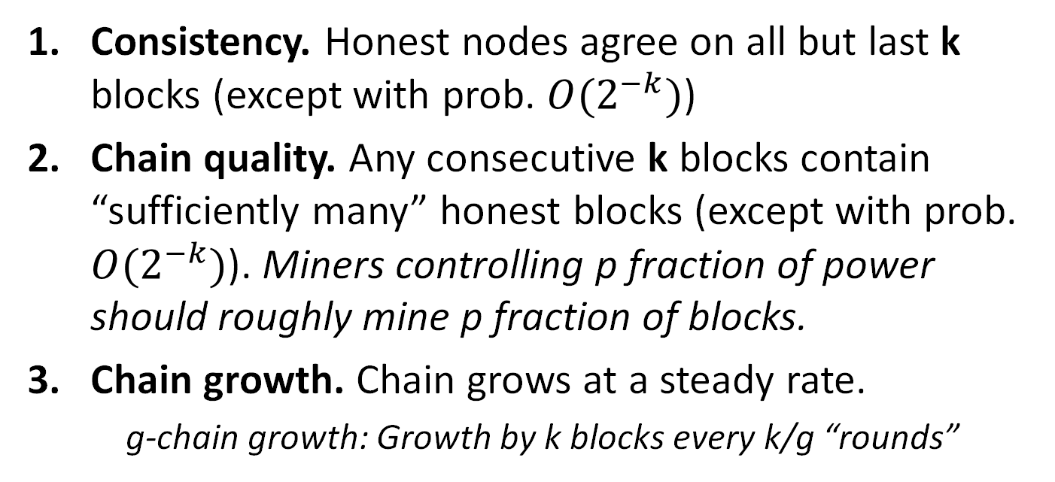
Nakamoto properties
Consistency. Honest nodes agree on all but last k blocks (except with prob. $O(2^{−k})$)
Chain quality. Any consecutive k blocks contain “sufficiently many” honest blocks (except with prob. $O(2^{−k})$). Miners controlling p fraction of power should roughly mine p fraction of blocks.
Chain growth. Chain grows at a steady rate.
g-chain growth: Growth by k blocks every k/g “rounds”

Slide 29
Nakamoto properties => Blockchain
Consistency implies Blockchain consistency
Chain growth + chain quality implies Blockchain liveness
The chain grows by k blocks every k/g periods
By chain quality, a high fraction of blocks are contributed by honest miners, and therefore include all transactions they heard so far

Slide 30
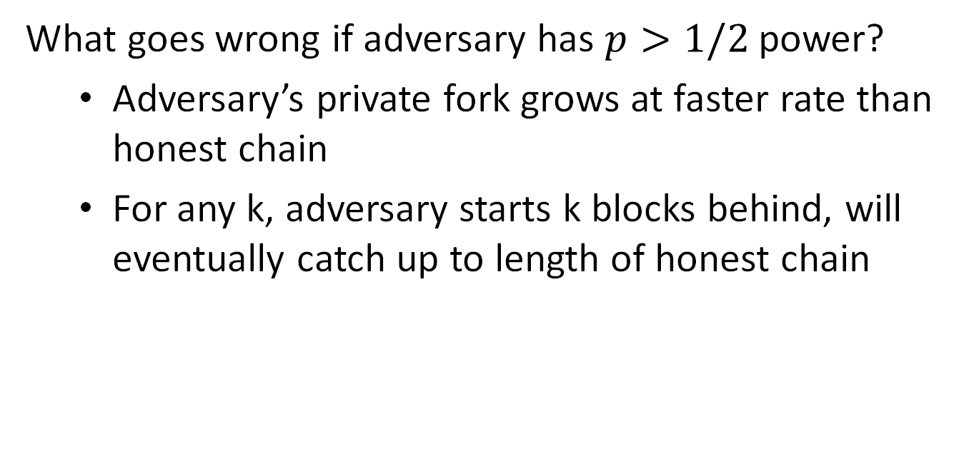
Nakamoto consensus
What goes wrong if adversary has $p>1/2$power?
Adversary’s private fork grows at faster rate than honest chain
For any k, adversary starts k blocks behind, will eventually catch up to length of honest chain

Slide 31
45% Attack
I’ll just produce a different chain
Cloud
No Car TX
3 BTC
For Car
Incur network delays and orphans

Slide 32
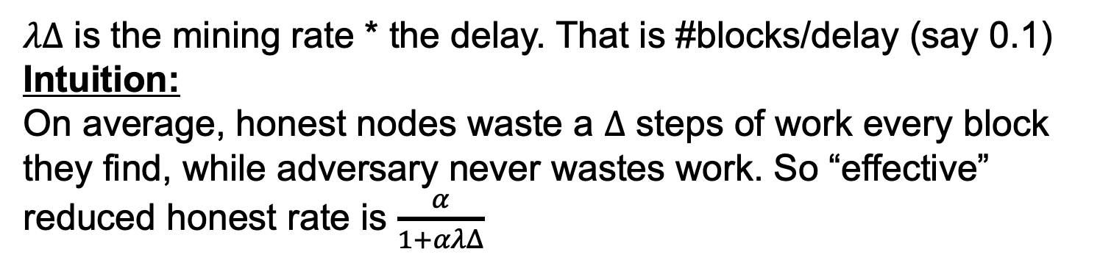

Nakamoto consensus
Adjusting difficulty for $Δ$
Formula from [SZ15]
Network mining rate (1 Block/10min)
Honest mining fraction (say 60%)
$$\frac{α}{1+αλΔ}>β$$
Adversary power (40%)
$λΔ$ is the mining rate * the delay. That is #blocks/delay (say 0.1)
Intuition:
On average, honest nodes waste a $Δ$ steps of work every block they find, while adversary never wastes work. So “effective” reduced honest rate is $\frac{α}{1+αλΔ}$
Notes:
$α\left(\frac{c}{c+1}\right)≈α\left(\frac{c−1}{c}\right)=α\left(1 −\frac{1}{c}\right)=α(1−αΔ)$

Slide 33

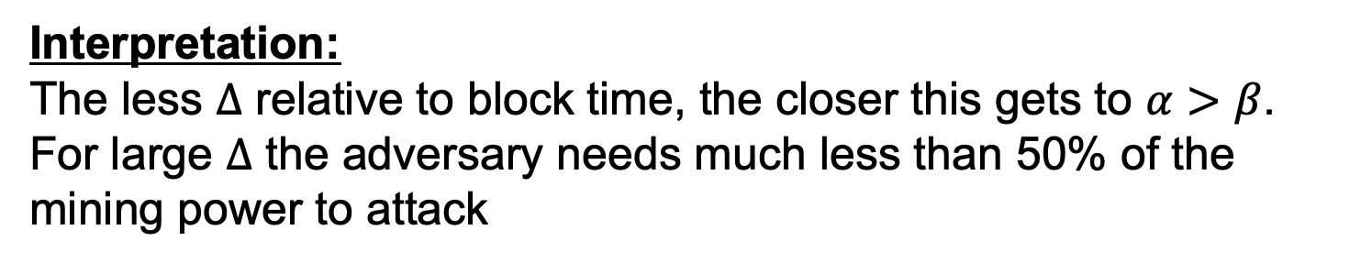
DKT+ Theorem
Theorem: There exists a k such that Nakamoto Consensus has consistency and liveness if and only if:
$$\frac{α}{1+αλΔ}>β$$
Private chain attack = Actual security (was an open question)
Interpretation:
The less $Δ$ relative to block time, the closer this gets to $α>β$.
For large $Δ$ the adversary needs much less than 50% of the mining power to attack
Notes:
$α\left(\frac{c}{c+1}\right)≈α\left(\frac{c−1}{c}\right)=α\left(1 −\frac{1}{c}\right)=α(1−αΔ)$

Slide 34
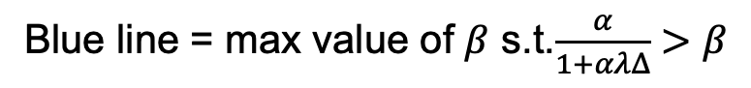
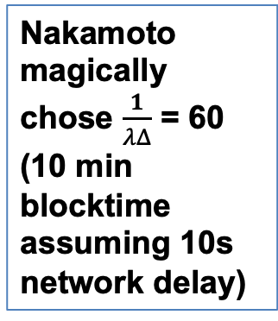
DKT+ Theorem Graph
Nakamoto magically chose $\frac{1}{λΔ}$ = 60 (10 min blocktime assuming 10s network delay)
Blue line = max value of $β$ s.t.$\frac{α}{1+αλΔ}>β$

Slide 35
Nakamoto Properties
Anonymous participation
Nodes can join/leave
Very scalable
Sleeping Beauty property
Leader not known beforehand
Makes bribing harder
Up to ½ corruptions
Slow
Even when everyone is honest
Resource intensive
PoS based possible
No finality
No guarantees under long delays

Slide 36
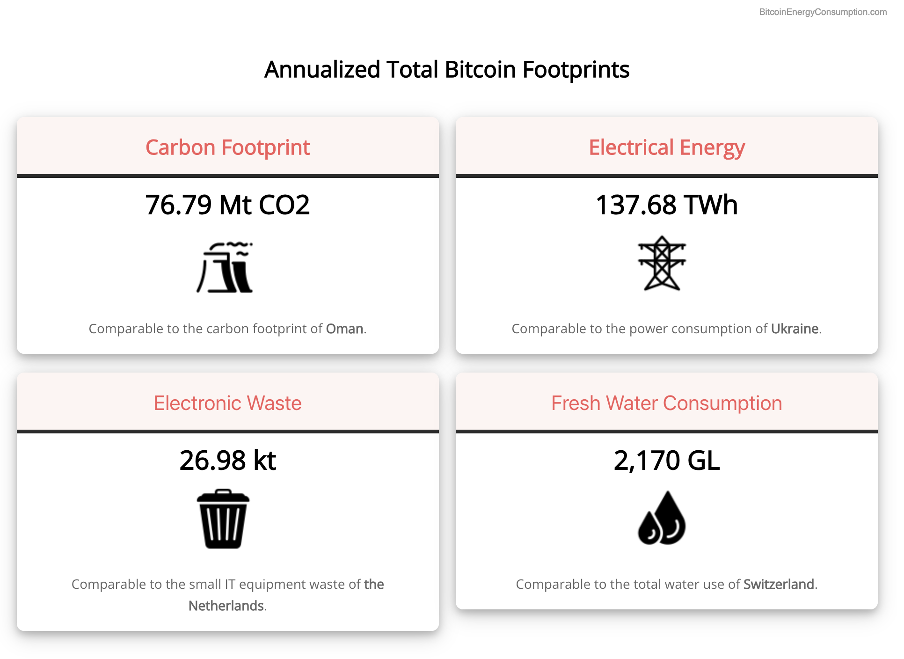
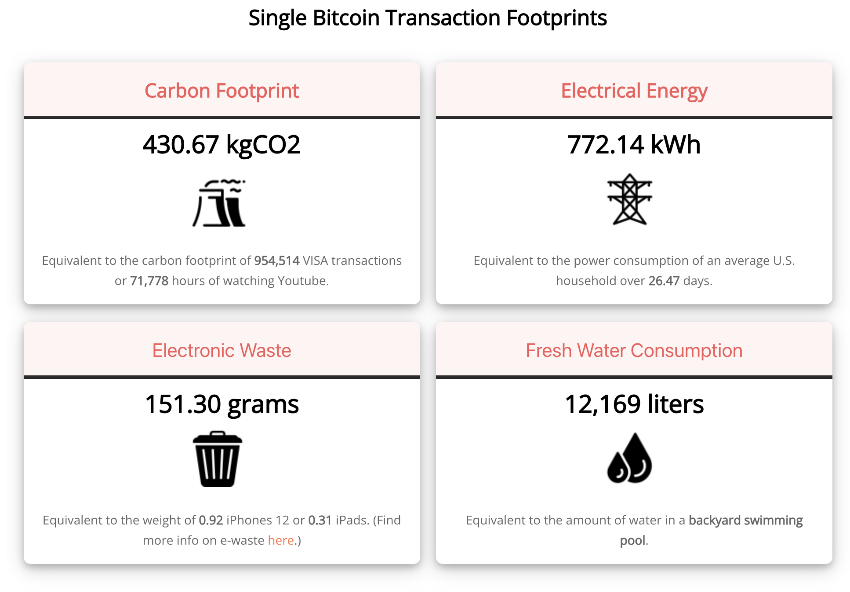
Proof of Work energy consumption

Slide 37
From Bitcoin to Proof-of-Stake
1982
2008
2015
2022
…
Time
The Byzantine Generals Problem
Bitcoin
PoW Ethereum
PoS Ethereum
Consensus in the Internet Setting
Sybil resistance
Dynamic availability
(Liveness under changing part.)
Block rewards (carrot)
to incentivize participation!
Consensus in the Internet Setting
Sybil resistance
Dynamic availability
Block rewards (carrot)
Finality and accountable safety
Slashing (stick)
to punish protocol violation!
The Byzantine Generals Problem (1982)
Bitcoin: A Peer-to-Peer Electronic Cash System (2008)
Ethereum: A Next-Generation Smart Contract and Decentralized Application Platform. (2015)
Combining GHOST and Casper (2020)

Slide 38
A few words on Proof-of-Stake (PoS)
In a Proof-of-Stake protocol, nodes lock up (i.e., stake) their coins in the protocol to become eligible to participate in consensus.
The more coins staked by a node…
Higher the probability that the node is elected as a leader.
Larger the weight of that node’s actions.
If a node is caught doing an adversarial action (e.g., sending two values), it can be punished by burning its locked coins (stake)! This is called slashing.
Thus, in a Proof-of-Stake protocol, nodes can be held accountable for their actions (unlike in Bitcoin, where nodes do not lock up coins).

Slide 39










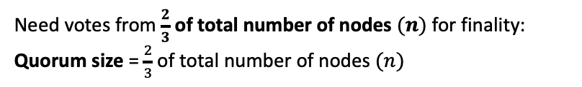
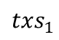
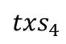
A Simple (PBFT-style) PoS Protocol*
Need votes from $\frac{2}{3}$ of total number of nodes $(n)$ for finality:
Quorum size = $\frac{2}{3}$ of total number of nodes $(n)$
Staked Coins
epochs
e
(9 nodes)
e+1
…
Vote by a node: Signature of the node on the block and the epoch
Alice’s log:
$${txs}_{1}$$
$${txs}_{4}$$
PBFT: Practical Byzantine Fault Tolerance. (1999)

Slide 40
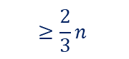
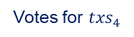
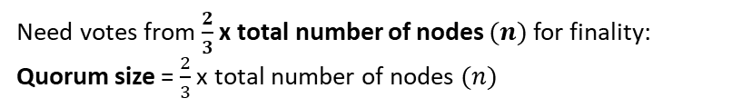

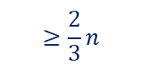
A Simple (PBFT-style) PoS Protocol*
Need votes from $\frac{2}{3}$ x total number of nodes $(n)$for finality:
Quorum size = $\frac{2}{3}$ x total number of nodes $(n)$
Staked Coins
epochs
e
Votes for ${txs}_{4}$
Votes for ${txs}_{5}$
$$≥\frac{2}{3}n$$
$$≥\frac{2}{3}n$$
e+1
…
Vote by a node: Signature of the node on the block and the epoch
Alice’s log:
$${txs}_{1}$$
$${txs}_{4}$$
PBFT: Practical Byzantine Fault Tolerance. (1999)

Slide 41
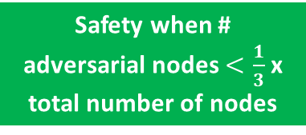
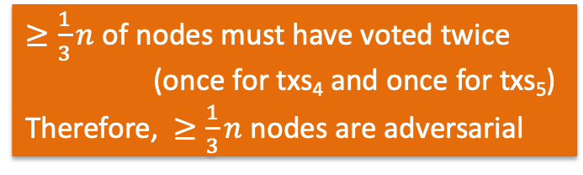
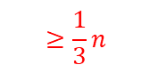
A Simple (PBFT-style) PoS Protocol*
Need votes from $\frac{2}{3}$ x total number of nodes $(n)$for finality:
Quorum size = $\frac{2}{3}$ x total number of nodes $(n)$
Staked Coins
epochs
e
Votes for ${txs}_{4}$
Votes for ${txs}_{5}$
$$≥\frac{2}{3}n$$
$$≥\frac{1}{3}n$$
$$≥\frac{2}{3}n$$
e+1
…
$≥\frac{1}{3}n$ of nodes must have voted twice (once for txs₄ and once for txs₅) Therefore, $≥\frac{1}{3}n$ nodes are adversarial
Safety when # adversarial nodes $<\frac{1}{3}$ x total number of nodes
Alice’s log:
$${txs}_{1}$$
$${txs}_{4}$$
PBFT: Practical Byzantine Fault Tolerance. (1999)

Slide 42

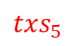
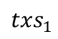
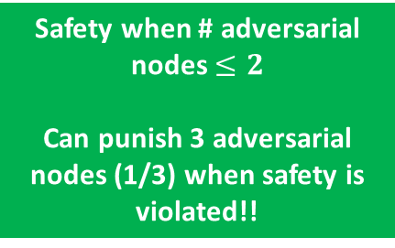
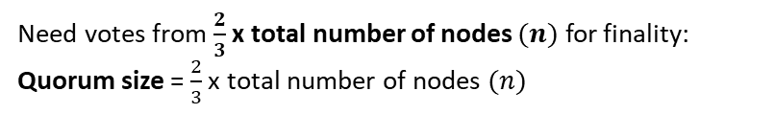
A Simple (PBFT-style) PoS Protocol*
Need votes from $\frac{2}{3}$ x total number of nodes $(n)$ for finality:
Quorum size = $\frac{2}{3}$ x total number of nodes $(n)$
Staked Coins
epochs
e
e+1
…
safety violation!
Alice’s log:
$${txs}_{1}$$
$${txs}_{4}$$
Bob’s log:
$${txs}_{1}$$
$${txs}_{5}$$

Slide 43


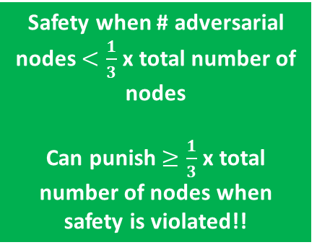
A Simple (PBFT-style) PoS Protocol*
Need votes from $\frac{2}{3}$ x total number of nodes $(n)$ for finality:
Quorum size = $\frac{2}{3}$ x total number of nodes $(n)$
Staked Coins
epochs
e
e+1
Safety when # adversarial nodes $<\frac{1}{3}$ x total number of nodes
Can punish $≥\frac{1}{3}$ x total number of nodes when safety is violated!!
…
Protocol violators!
safety violation!
Alice’s log:
$${txs}_{1}$$
$${txs}_{4}$$
Bob’s log:
$${txs}_{1}$$
$${txs}_{5}$$

Slide 44
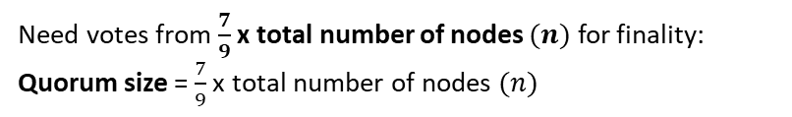
A Simple (PBFT-style) PoS Protocol*
Need votes from $\frac{7}{9}$ x total number of nodes $(n)$ for finality:
Quorum size = $\frac{7}{9}$ x total number of nodes $(n)$
Staked Coins
epochs
e
e+1
…

Slide 45
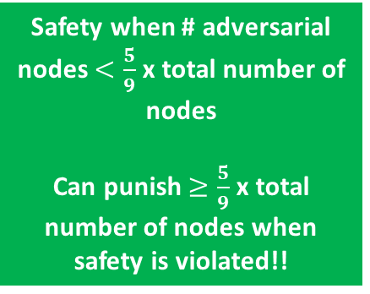
A Simple (PBFT-style) PoS Protocol*
Need votes from $\frac{7}{9}$ x total number of nodes $(n)$ for finality:
Quorum size = $\frac{7}{9}$ x total number of nodes $(n)$
Staked Coins
epochs
e
e+1
Safety when # adversarial nodes $<\frac{5}{9}$ x total number of nodes
Can punish $≥\frac{5}{9}$ x total number of nodes when safety is violated!!
…
Protocol violators!

Slide 46
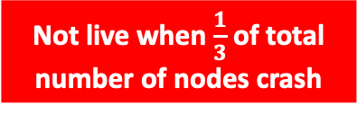
A Simple (PBFT-style) PoS Protocol*
Need votes from $\frac{2}{3}$ x total number of nodes $(n)$ for finality:
Quorum size = $\frac{2}{3}$ x total number of nodes $(n)$
Staked Coins
epochs
e
e+1
…
Not live when $\frac{1}{3}$ of total number of nodes crash
Alice’s log:
$${txs}_{1}$$

Slide 47
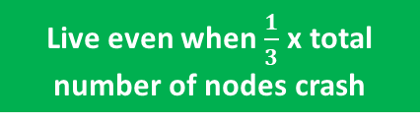
A Simple (PBFT-style) PoS Protocol*
Need votes from $\frac{2}{3}$ x total number of nodes $(n)$ for finality:
Quorum size = $\frac{2}{3}$ x total number of nodes $(n)$
Staked Coins
epochs
e
e+1
…
Live even when $\frac{1}{3}$ x total number of nodes crash
Alice’s log:
$${txs}_{1}$$
$${txs}_{4}$$

Slide 48
A Simple (PBFT-style) PoS Protocol*
Sybil resistance mechanism determines how to select the nodes that are eligible to participate in consensus and propose/vote for transactions/blocks.
Consensus protocol specifies the instructions for honest nodes so that given a set of eligible nodes with sufficiently many being honest, safety and liveness are satisfied.
Sybil resistance mechanism: Consensus protocol (SMR): | Proof-of-Work | Proof-of-Stake
Nakamoto consensus (longest chain) | Bitcoin PoW Ethereum | Ouroboros
PBFT-style (with votes) | ?? | PoS Ethereum* Simple PBFT-style PoS protocol
satisfies dynamic availability
satisfies finality and accountable safety
Ouroboros Genesis: Composable Proof-of-Stake Blockchains with Dynamic Availability. (2019)

Slide 49
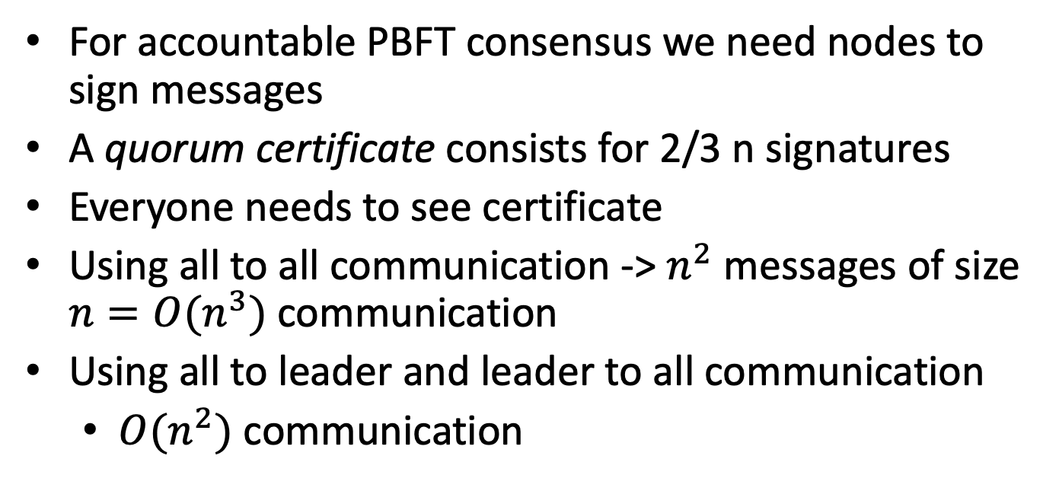
Consensus signatures
For accountable PBFT consensus we need nodes to sign messages
A quorum certificate consists for 2/3 n signatures
Everyone needs to see certificate
Using all to all communication -> $n^{2}$ messages of size $n=O(n^{3})$ communication
Using all to leader and leader to all communication
$O(n^{2})$ communication

Slide 50
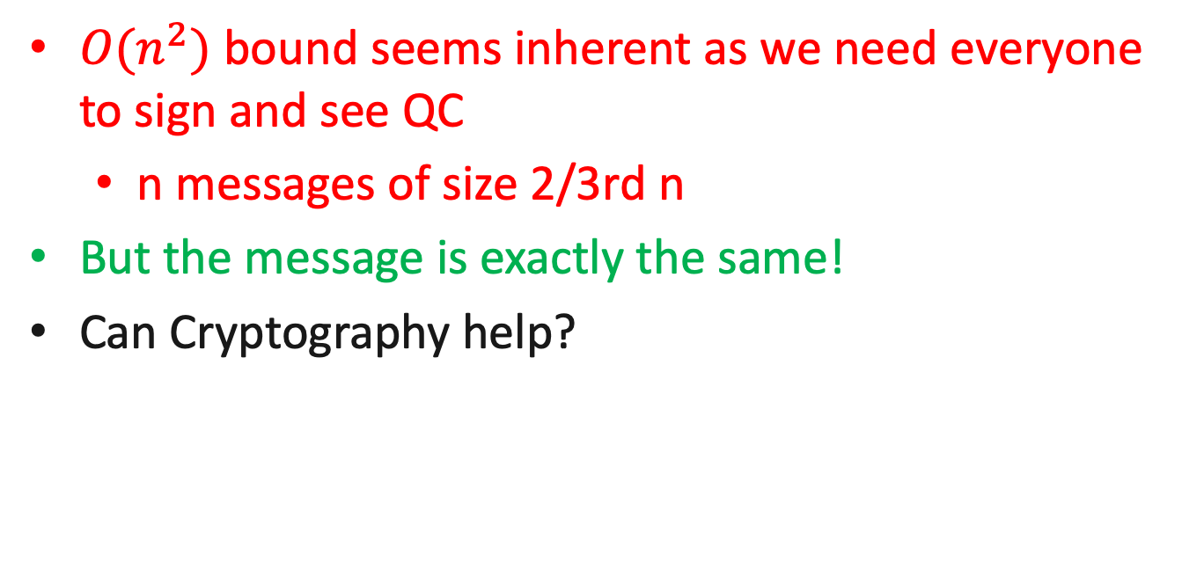
N^2 Lower Bound?!
$O(n^{2})$ bound seems inherent as we need everyone to sign and see QC
n messages of size 2/3rd n
But the message is exactly the same!
Can Cryptography help?

Slide 51
A Simple (PBFT-style) PoS Protocol*
Need votes from $\frac{2}{3}$ of total number of nodes $(n)$ for finality:
Quorum size = $\frac{2}{3}$ of total number of nodes $(n)$
Staked Coins
epochs
e
(9 nodes)
e+1
…
Vote by a node: Signature of the node on the block and the epoch
Alice’s log:
$${txs}_{1}$$
$${txs}_{4}$$
PBFT: Practical Byzantine Fault Tolerance. (1999)

Slide 52
Aggregate signatures

Slide 53
Aggregate signatures
Aggregate
Problem: Can’t be accountable
Solution: Add bitvector (n bits)

Slide 54
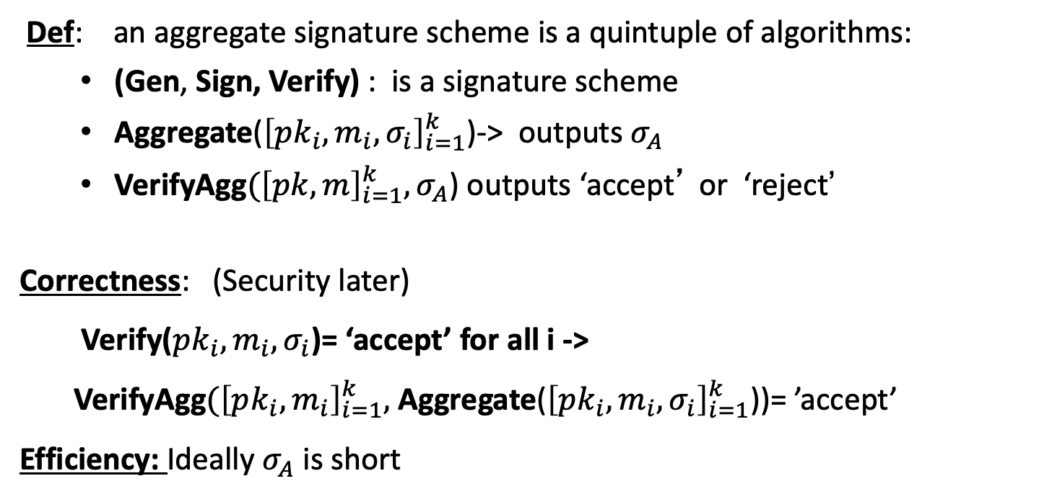
Aggregate signatures: syntax
Def: an aggregate signature scheme is a quintuple of algorithms:
(Gen, Sign, Verify) : is a signature scheme
Aggregate(${\left[pk_{i},m_{i},σ_{i}\right]}_{i=1}^{k}$)-> outputs $σ_{A}$
VerifyAgg$({\left[pk, m\right]}_{i=1}^{k}, σ_{A}$) outputs ‘accept’ or ‘reject’
Correctness: (Security later)
Verify($pk_{i},m_{i},σ_{i}$)= ‘accept’ for all i ->
VerifyAgg$({\left[pk_{i}, m_{i}\right]}_{i=1}^{k},$ Aggregate(${\left[pk_{i},m_{i},σ_{i}\right]}_{i=1}^{k}$))= ’accept’
Efficiency: Ideally $σ_{A}$ is short

Slide 55
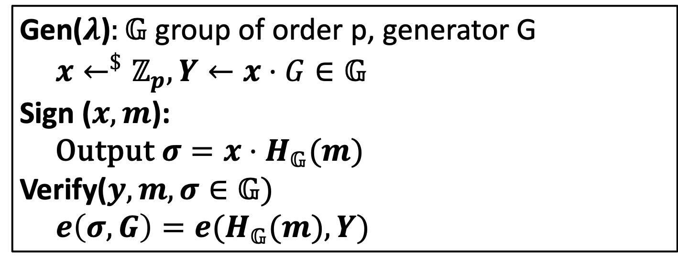
BLS aggregate sig scheme (Attempt 1)
Gen($λ$)$:𝔾$ group of order p, generator G
$x←^{\$}ℤ_{p},Y←x⋅G∈𝔾$
Sign ($x,m$):
Output $σ=x⋅H_{𝔾}(m)$
Verify($y,m,σ∈𝔾)$
$e\left(σ,G\right)=e(H_{𝔾}(m),Y)$

Slide 56
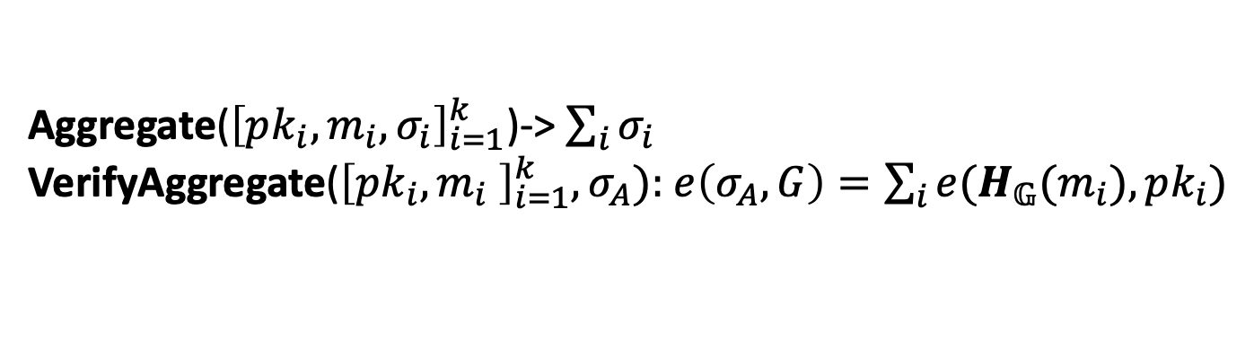
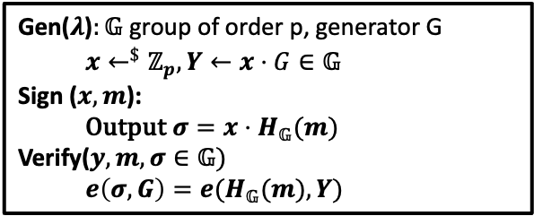
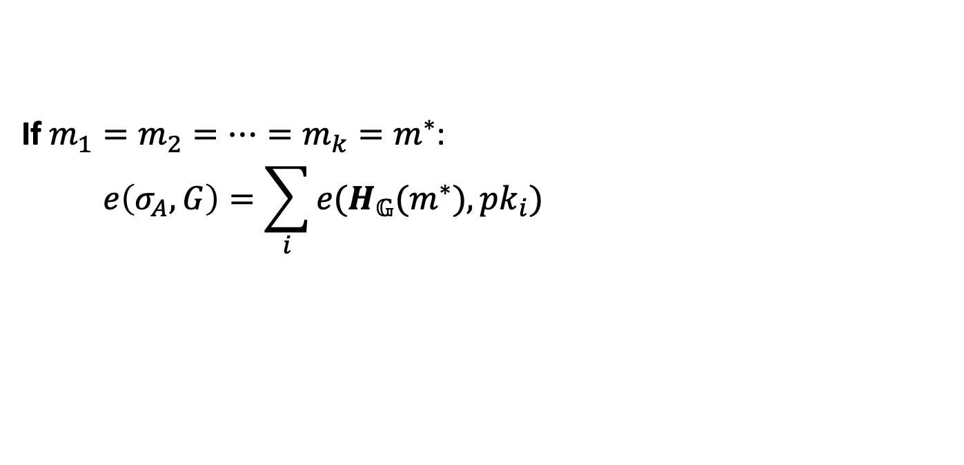
BLS aggregate sig scheme (Attempt 1)
Gen($λ$)$:𝔾$ group of order p, generator G
$x←^{\$}ℤ_{p},Y←x⋅G∈𝔾$
Sign ($x,m$):
Output $σ=x⋅H_{𝔾}(m)$
Verify($y,m,σ∈𝔾)$
$e\left(σ,G\right)=e(H_{𝔾}(m),Y)$
Aggregate(${\left[pk_{i},m_{i},σ_{i}\right]}_{i=1}^{k}$)-> $\sum_{i}{σ_{i}}$
VerifyAggregate(${\left[pk_{i},m_{i} \right]}_{i=1}^{k},σ_{A}):$ $e\left(σ_{A},G\right)=\sum_{i}{e(H_{𝔾}(m_{i}),pk_{i})}$
If $m_{1}=m_{2}=…=m_{k}=m^{∗}$:
$$e\left(σ_{A},G\right)=\sum_{i}{e(H_{𝔾}(m^{∗}),pk_{i})}=e(H_{𝔾}(m^{∗}),\sum_{i}{pk_{i}})$$

Slide 57
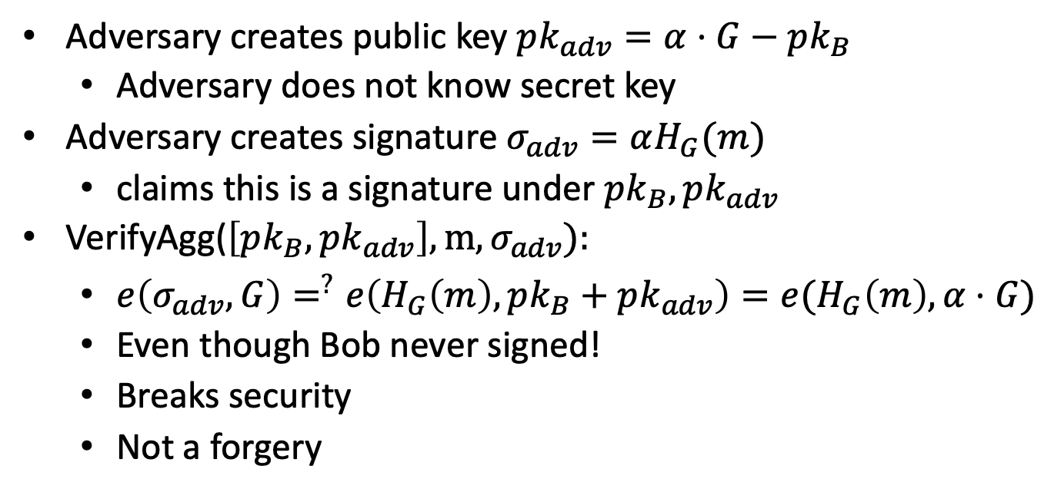
Rouge Key Attack
Adversary creates public key $pk_{adv}=α⋅G−pk_{B}$
Adversary does not know secret key
Adversary creates signature $σ_{adv}=αH_{G}(m)$
claims this is a signature under $pk_{B},pk_{adv}$
VerifyAgg($\left[pk_{B},pk_{adv}\right],m,σ_{adv}):$
$e\left(σ_{adv},G\right)=^{?}e\left(H_{G}\left(m\right),pk_{B}+pk_{adv}\right)=e(H_{G}\left(m\right),α⋅G)$
Even though Bob never signed!
Breaks security
Not a forgery

Slide 58
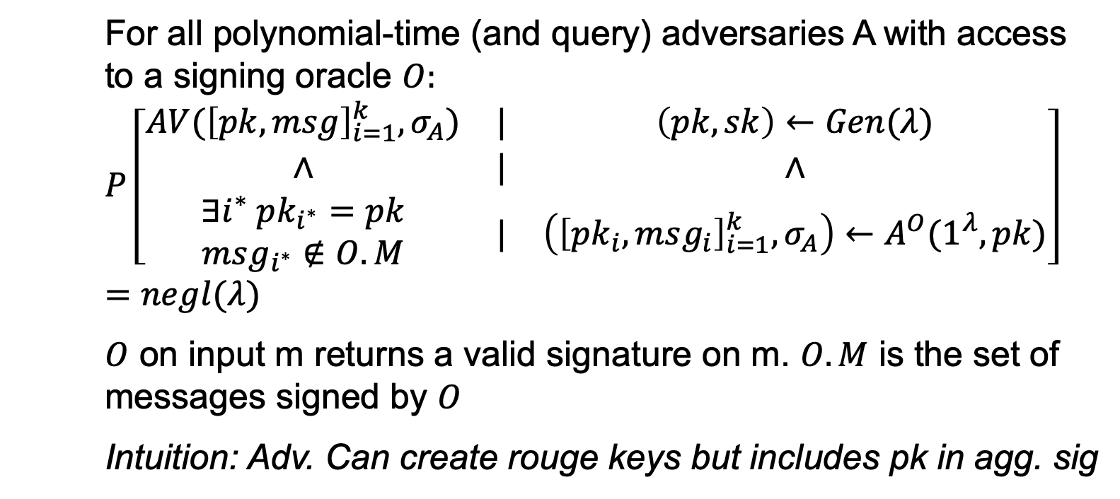
Modelling security
For all polynomial-time (and query) adversaries A with access to a signing oracle $O:$
$$P\left[\begin{matrix}AV({\left[pk,msg\right]}_{i=1}^{k},σ_{A}) & | & \left(pk,sk\right)←Gen(λ) \\ ∧ & | & ∧ \\ \begin{aligned}∃i^{∗} pk_{i^{∗}}=pk \\ msg_{i^{∗}}∉O.M\end{aligned} & | & \left({\left[pk_{i},msg_{i}\right]}_{i=1}^{k},σ_{A}\right)←A^{O}(1^{λ},pk)\end{matrix}\right]=negl(λ)$$
$O$ on input m returns a valid signature on m. $O.M$ is the set of messages signed by $O$
Intuition: Adv. Can create rouge keys but includes pk in agg. sig

Slide 59
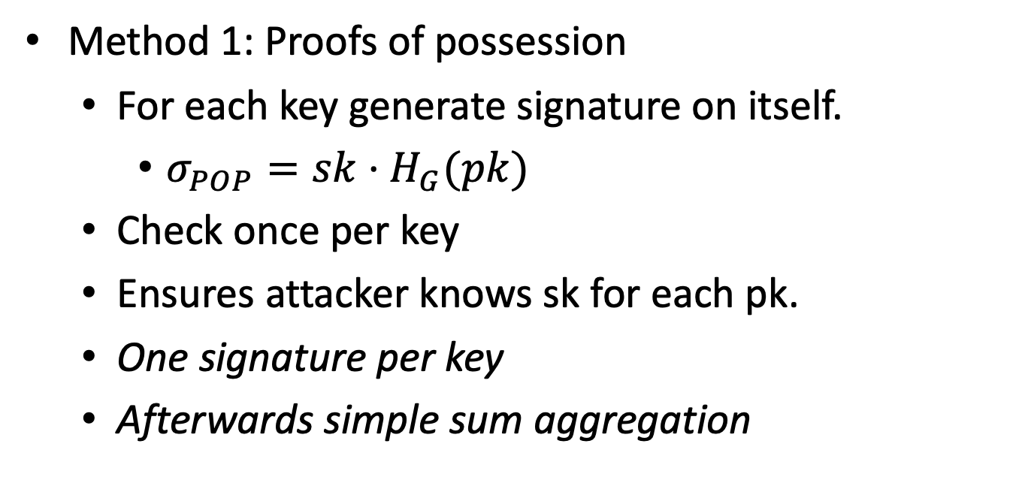
BLS Agg signature
Method 1: Proofs of possession
For each key generate signature on itself.
$σ_{POP}=sk⋅H_{G}(pk)$
Check once per key
Ensures attacker knows sk for each pk.
One signature per key
Afterwards simple sum aggregation

Slide 60

BLS Agg signature
Method 2: Random linear combination
Assume $m_{1}=m_{2},…=m^{∗}$
H: $𝔾^{k}→𝔽$ modeled as random oracle
$c_{1},…,c_{k}←H(pk_{1},…,pk_{k})$; random challenges
Aggregate: $\sum_{i}{c^{i−1}⋅σ_{i}}$
VerifyAgg: $e\left(σ_{A},G\right)=\sum_{i}{c_{i}}⋅e(H_{G}\left(m_{i}\right), pk_{i})$
One signature but one scalar mult per key

Slide 61

Random linear comb security
Intuition:
Rouge key attack canceled out Bob’s key:
$pk_{adv}=αG−pk_{B}$
Given that $c$ is chosen after the keys the adversary cannot cancel out key as $pk_{adv}+c pk_{B}≠αG$ even if $pk_{adv}+pk=αG$.
For security proof we need to show that given k sets of challenges ${[c}_{i}^{(1)}] ,{[c}_{i}^{(2)}],…,{[c}_{i}^{(k)}]$and aggregate signatures $σ_{A,1 },σ_{A,2},…,σ_{A,k}$ we can compute individual (non aggregate) signatures $σ_{1},…,σ_{k}$
Homework!

Slide 62
Making the scheme accountable
For slashing we need that signature identifies who signed
Aggregate signature provides this but requires list of public keys
Can be compressed using a bitmap (indicates which keys signed).
Size <= n bits

Slide 63
Merkle Tree based QC
Say we don’t need to know who signed only that sufficient number signed (not slashable)
Can we get a scheme without pairings/BLS
Assume that instead of 2/3rd , 5/6th signed
Idea: Subsample signatures

Slide 64

Merkle based QC [MRVWZ20]
Assume a list of k claimed signers (say $\frac{5}{6}th$of all nodes)
Produce a Merkle Tree of all signatures
Sample (using a hash function) a random index i in 1,…,k
Open path to ith signature
Repeat $ℓ$ times
Verifier checks all $ℓ$ signatures

Slide 65

Merkle based QC analysis
Assume there are less than $\frac{2}{3}rd$ real signatures on the message.
This means that at least $\frac{5}{6}−\frac{2}{3}=\frac{1}{6}$ signatures must be invalid
Every random sample has a $\frac{1}{6}th$ chance of catching an adversary
The probability an adversary succeeds on $ℓ$ challenges is ${\left(\frac{5}{6}\right)}^{ℓ}$
For $ℓ≥456$ the probability is <$2^{−120}$
Independent of k or n
Useful if n (total nodes) is huge
$ℓ$ can be reduced using beacons (next lecture)

Slide 66
END OF LECTURE
Next lecture: Beacons and VDFs

